Slide 1
EXECUTIVE COUNCIL MEETING
January 8, 2026
Adam Scott

Slide 2
AGENDA
Call to Order
Cocktail Presentation
Warm-up Album One Presentation
Old Business: Review & Approval of the Minutes
New Business: New Music, Books, & Video; New Purchases; Concerts; etc.
Warm-up Album Two Presentation
Musicology
Headliner Album Presentation
Wrap Up

Slide 3
CALL TO ORDER
Executive Officers
Chris Clement
Joe Ziegler
John Williams
Regional Manager
Adam Scott
Janitor
Lucas Womack
Guests

Slide 4

COCKTAIL PRESENTATION
C&B Old Fashioned
Ingredients:
1.5 oz Gin
0.75 oz Campari
0.75 oz Lillet Blanc
0.25 oz Benedictine
0.25 oz Cointreau
Club soda, chilled, to top
Garnish: orange twist
Steps:
Add all ingredients (except club soda) into a shaker with ice and shake until well-chilled.
Strain into a rocks glass over fresh ice
Top with club soda and stir briefly and gently to combine
Garnish with an orange twist

Slide 5
COCKTAIL PRESENTATION
C&B Old Fashioned
The C&B Old Fashioned is named for the cocktail’s use of Campari and Benedictine, but the drink also calls for Lillet Blanc and Cointreau in addition to the gin. If you’re counting, that’s one spirit, three liqueurs, and a wine-based aperitif.
It’s an original recipe from New York bartending veteran and distiller Allen Katz. Katz helped to forge the modern face of New York City’s distilling scene—his Brooklyn company opened in 2011 with two American-style gins. Today, many count him among the ranks of America’s spirit luminaries.

Slide 6
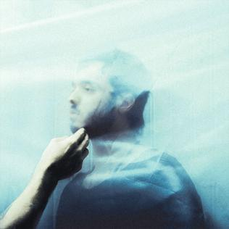
WARM-UP ALBUM ONE
Boots - AQUΛRIA
Released: November 13, 2015
Label: Columbia
Producer: BOOTS, El-P, Carla Azar, Gabe Wax
Debut studio album by the American record producer, singer-songwriter, rapper and musician Boots. The album has charted at number 14 on the Billboard Top Heatseekers chart in the United States.
Boots came to worldwide attention in December 2013 when Beyoncé released her highly successful fifth studio album Beyoncé, for which BOOTS had written and produced several songs.
On AQUΛRIA, Boots combines the best of R&B, rock, electronic, rap, and pop sensibilities for a futuristic sound that comes close to achieving a musical mono-genre singularity.

Slide 7
OLD BUSINESS: REVIEW & APPROVAL OF THE MINUTES
VCL 11/13/2025 Notes
Joe and John saw Sir Paul at Nationwide in CBus
Park Street - dive bar w/ a live band after the concert
Joe sad the concert was top notch
Cocktail: Mexican Firing Squad, discovered at a bar La Cucaracha (“The Cockroach”) in Mexico City around 1937
Warm-Up Album 1: Patty Smith - Horses. [ChatGPT was used to provide notes about the album] Is John lazy or resourceful?
Joe sneezed and asked if the heart stops when you sneeze - NO. Lucas said rumors start from sneezing
Mansfield is famous for Carousel Works - renowned manufacturer of hand-carved wooden carousels
Warm up album 2: Sinead O’Connor - The Lion and the Cobra
Lucas drank with Waxahatchee and inspired her to enter rehab for drinking
Cure film coming to theaters - John suggested a VCL field trip

Slide 8
OLD BUSINESS: REVIEW & APPROVAL OF THE MINUTES
VCL 11/13/2025 Notes
John screwed up the 2nd round of drinks - he forgot the bitters. Should be called the Fraud Squad
Chris got a birthday shout out at the Nations of Language concert
Musicology: Paul McCartney - Arguably the most important musician of our lifetime
Headliner: Liz Phair - Exile to Guyville
Joes says we are subsidizing slavery by listening to Spotify. Streaming services pay very little for each play of an artist’s track

Slide 9
NEW BUSINESS New Music, Video, Books, Purchases, Concerts, etc.
Joe
Listening to: Dr John (Mac Rebenach), Tyler Childers, Paul McCartney (diving into his 26! Solo albums), Jesse Wells, Billy Strings, Stephen Wilson Jr., Midnight Cowgirls, Хиггса | Вокально (not sure…Russian a cappella group), BandMaid (all girl Japanese band), Father of Peace (Israeli 3 piece)
Purchased:
Books: The Uncool - Cameron Crowe biography, Wings Story, Rolling Stone 50th Anniversary, living in the present - John Prine, Insomnia - Robbie Robertson, Burning Down the House - Talking Heads
Shows: Still making mortgage payments on McCartney show

Slide 10
NEW BUSINESS New Music, Video, Books, Purchases, Concerts, etc.
Chris
Listening: Geese – Getting Killed; Automatic – Is It Now?; HEALTH – Conflict DLC; Die Spitz – Something to Consume; Depeche Mode – Ultra, MFTM, etc.; Cut Copy – Moments
Purchased: Vinyl: Automatic x3; Geese – Getting Killed; Severance S2; Lou Reed – Transformer; Morphine – Good; Youth Code – Commitment To Complications; Erasure – Chorus; Massive Attack v. Mad Professor Part II; etc. CD’s: None Cassette: None
Shows: David Byrne 10/25, Sir Paul McCartney 11/25 @ United Center in Chicago
Upcoming Shows: Gary Numan 3/28, Lords of Acid 5/7, Echo & the Bunneymen 6/16

Slide 11
NEW BUSINESS New Music, Video, Books, Purchases, Concerts, etc.
John
Listening - Orcutt, Shelly Miller, The Tubs, J Mascis, The Silversound, Cameron Winter, The Afghan Whigs Purchases - The Pogues - Rum Sodomy & the Lash Books - Rumors of My Demise - Evan Dando
Shows - none

Slide 12
NEW BUSINESS New Music, Video, Books, Purchases, Concerts, etc.
Adam
Listening: Balthazar (Belgian indie pop/rock), Warhaus (solo project of zMaarten Devoldere from Balthazar), Steve Gunn, BALTHVS (Columbian psych rock band), Gelli Haha - Switcheroo (a mix between Animal Collective and Kate Bush), Benjamin Booker - LOWER, The Glove - Blue Sunshine (Cure/Siouxsie supergroup), Blood Orange - Essex Honey (electronica, drum ’n’ bass, funk)
Purchased: Balthazar - Rats, Paul Cauthen - Room 41
Books: none
Shows: Shame 1/24/26 - The Loving Touch, Ferndale
Listening To:Jadu Heart - described as Dream Pop, Shoegaze (saw them open for Fontaines DC)Roscoe Tripp - It Always Starts with Something (reminds me a little of Modest Mouse)Umphrey’s Mcgee - Zonkey (amazing mashup album!)Chemtrails - The Joy of Sects (quirky garage/punk power pop from UK)PACKS - Melt the Honey (described as indie rock band from Toronto; honors the inventive arrangements of Guided by Voices)
Listening To:Jadu Heart - described as Dream Pop, Shoegaze (saw them open for Fontaines DC)Roscoe Tripp - It Always Starts with Something (reminds me a little of Modest Mouse)Umphrey’s Mcgee - Zonkey (amazing mashup album!)Chemtrails - The Joy of Sects (quirky garage/punk power pop from UK)PACKS - Melt the Honey (described as indie rock band from Toronto; honors the inventive arrangements of Guided by Voices)
Listening To:Jadu Heart - described as Dream Pop, Shoegaze (saw them open for Fontaines DC)Roscoe Tripp - It Always Starts with Something (reminds me a little of Modest Mouse)Umphrey’s Mcgee - Zonkey (amazing mashup album!)Chemtrails - The Joy of Sects (quirky garage/punk power pop from UK)PACKS - Melt the Honey (described as indie rock band from Toronto; honors the inventive arrangements of Guided by Voices)
Listening To:Jadu Heart - described as Dream Pop, Shoegaze (saw them open for Fontaines DC)Roscoe Tripp - It Always Starts with Something (reminds me a little of Modest Mouse)Umphrey’s Mcgee - Zonkey (amazing mashup album!)Chemtrails - The Joy of Sects (quirky garage/punk power pop from UK)PACKS - Melt the Honey (described as indie rock band from Toronto; honors the inventive arrangements of Guided by Voices)

Slide 13
NEW BUSINESS New Music, Video, Books, Purchases, Concerts, etc.
Lucas
Listening: Geese, Snocaps, Wet Leg
Purchases: Wilco - Yankee Hotel Foxtrot, Radiohead - A Moon Shaped Pool, Christine and the Queens (self titled)
Docs/Books: none
Shows: David Byrne - 5/27 @ Playhouse Square

Slide 14
NEW BUSINESS
New Music, Video, Books, Purchases, Concerts, etc.
VCL Top 5 of 2025
Joe: 1) Bad Bunny, 2) Lady Gaga, 3) Rosalia, 4) Dijon Baby, 5) Brittany Spears 25th anniversary release of Oops, I Did It Again
John: Wednesday - Bleeds, Jeff Tweedy - Twilight Overdrive, Geese - Getting Killed, Hot TNT - Raspberry Moon, The Men - Buyer Beware
Adam: 1) Throwing Muses - Moonlight Concessions, 2) Blood Orange - Essex Honey, 3) Destroyer - Dan’s Boogie, 4) Gelli Haha - Switcheroo, 5) Panda Bear - Sinister Gift
Lucas: 1) Alex G - Headlights, 2) Geese - Getting Killed, 3) Snocaps - Snocaps, 4) Wet Leg - Moisturizer, 5) Perfume Genius – Glory
Chris: 1) Nation of Language – Dance Called Memory, 2) Deftones – Private Music, 3) Pixel Grip – Percepticide: The Death of Reality, 4) Sleep Token – Even In Arcadia, 5) Automatic – Is It Now? (Runner up – Snapped Ankles – Hard Times Furious Dancing)

Slide 15
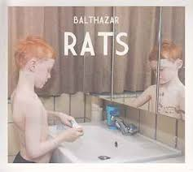
WARM UP ALBUM TWO
Balthazar - Rats
Released: October 15, 2012
Label: Munich Records
Producer: Jinte Deprez, Maarten Devoldere
The album was mixed by Noah Georgeson (Devendra Banhart, The Strokes) in Los Angeles. At the Music Industry Awards in 2012, the band again won the award for best album.^{[7]} Recognition for the album went beyond Belgium and the Netherlands: in France, the prestigious newspaper Libération claimed it was the best album released in 2012.^{[8][9]}

Slide 16
Musicology by Chris Clement

Slide 17
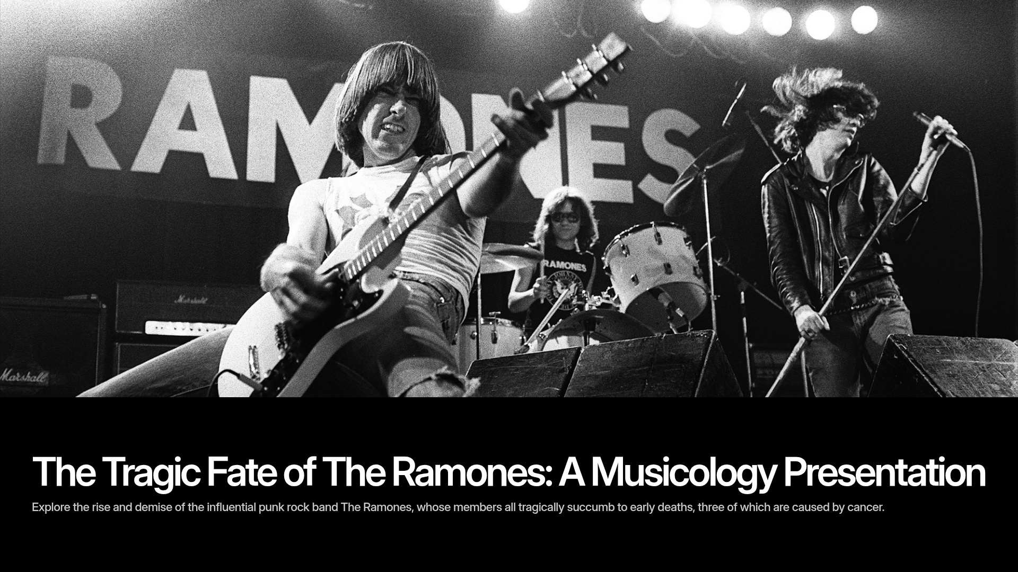

Slide 18
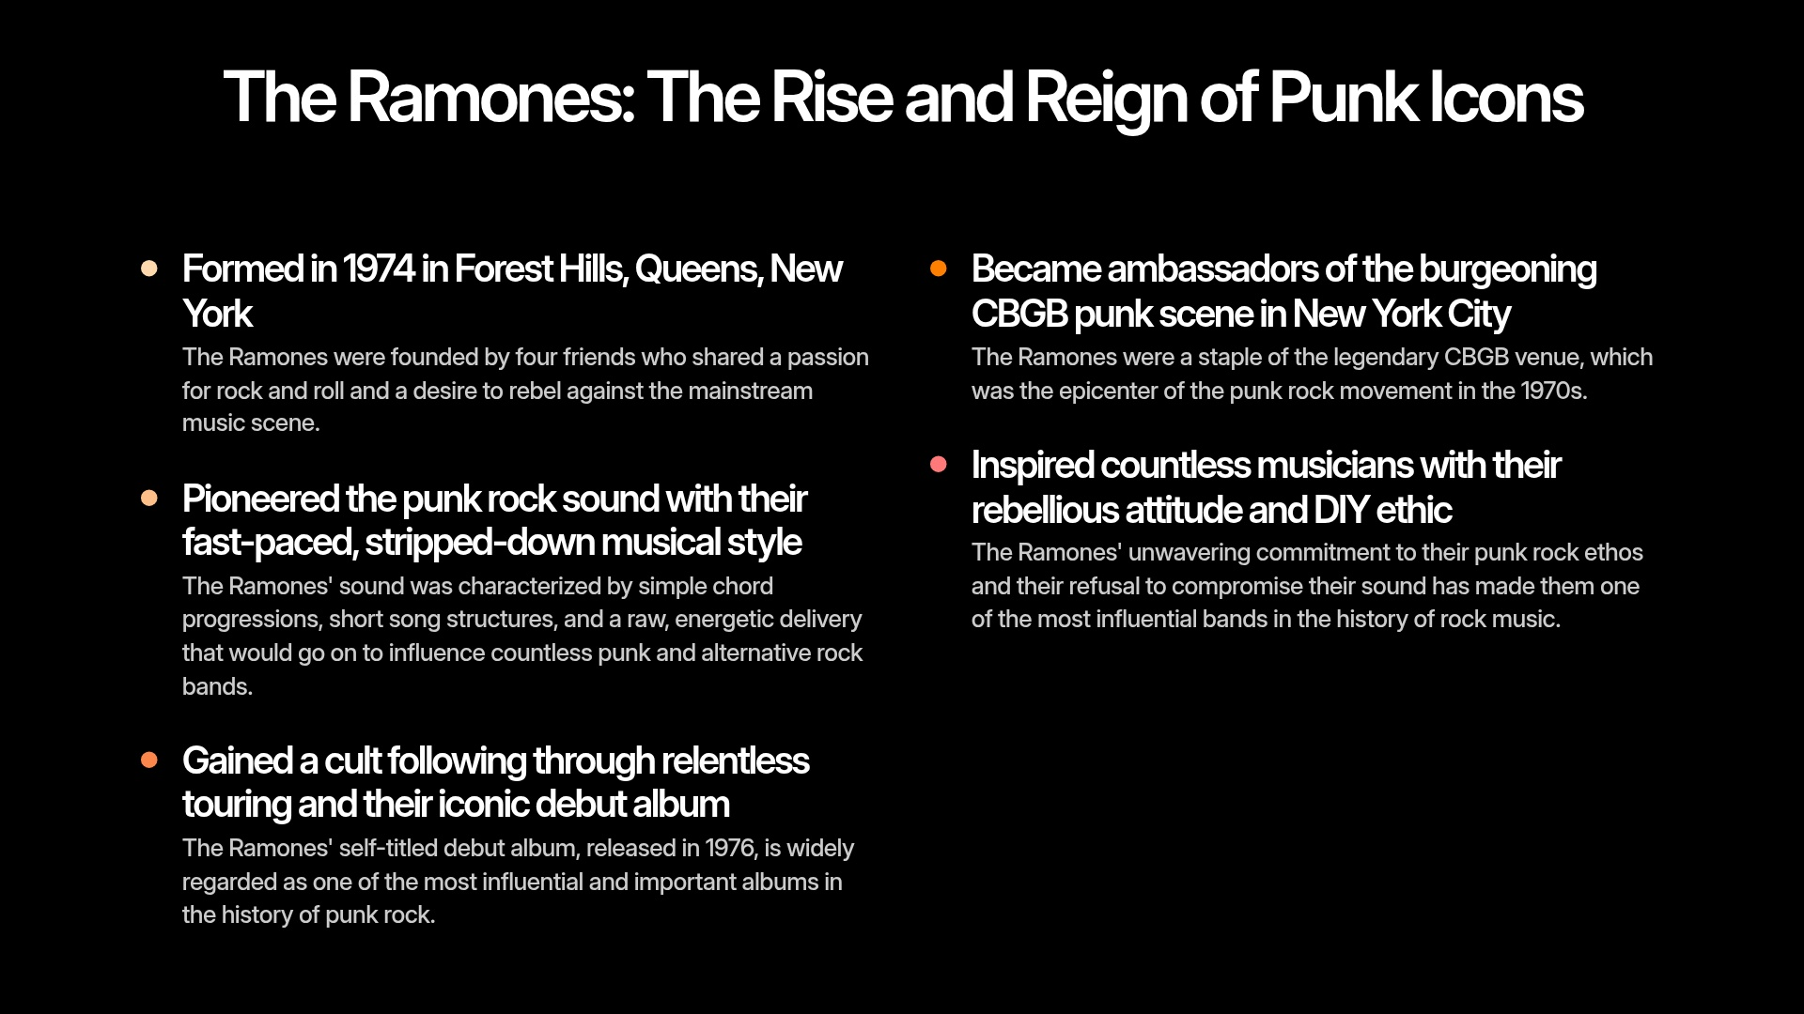

Slide 19
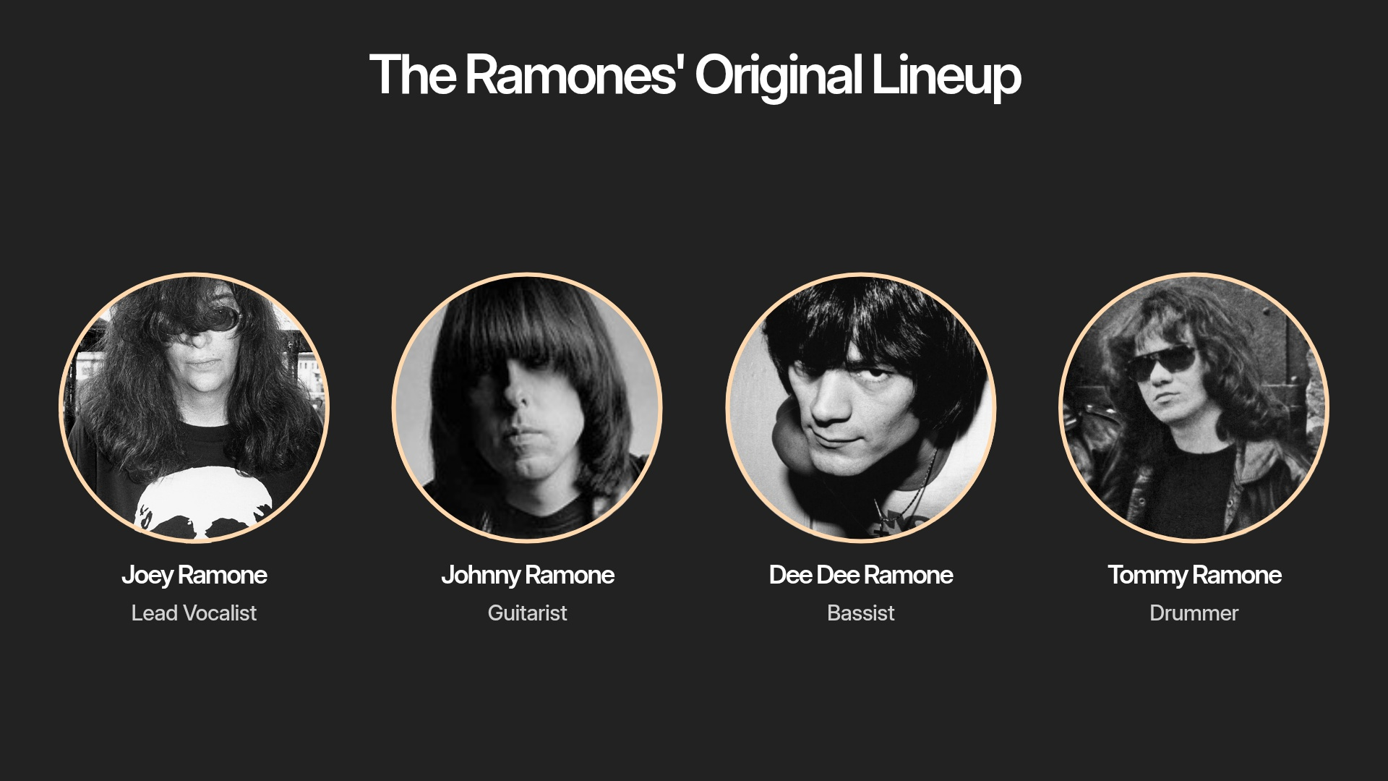

Slide 20
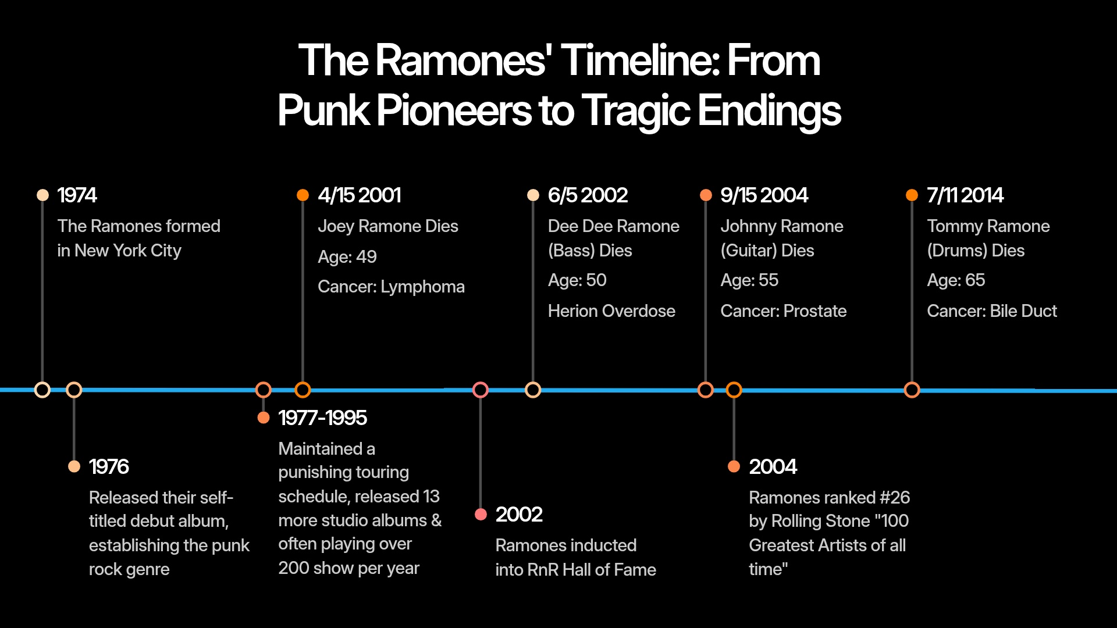

Slide 21


Slide 22
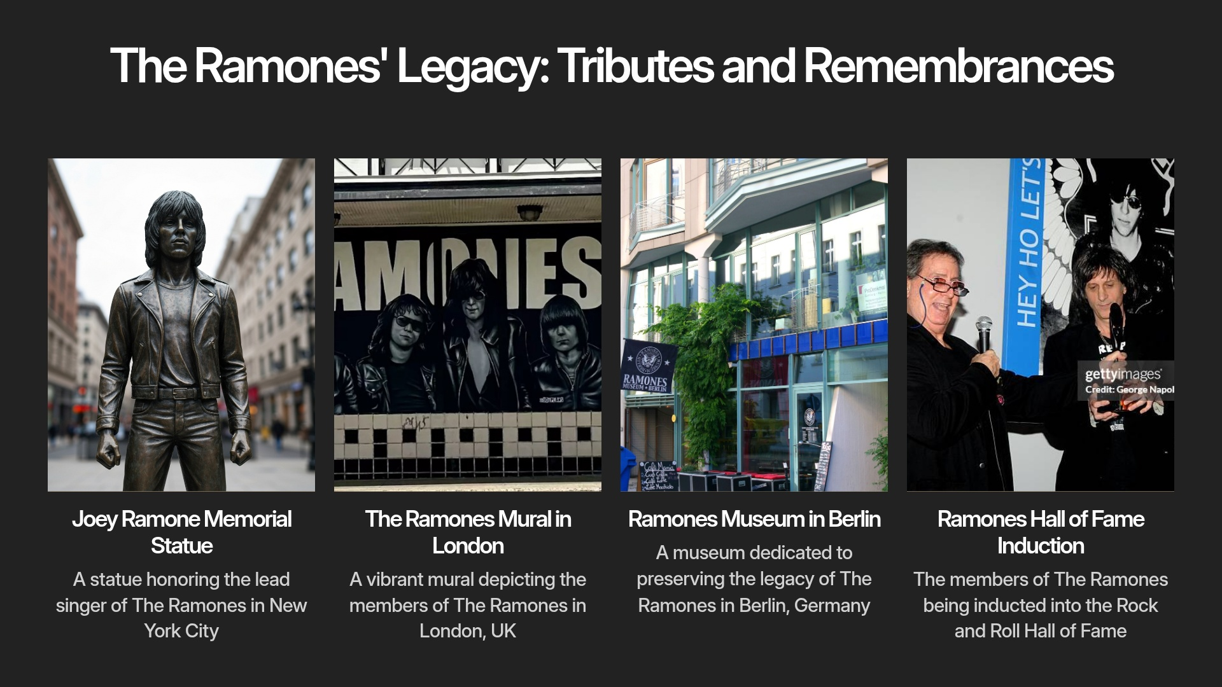

Slide 23
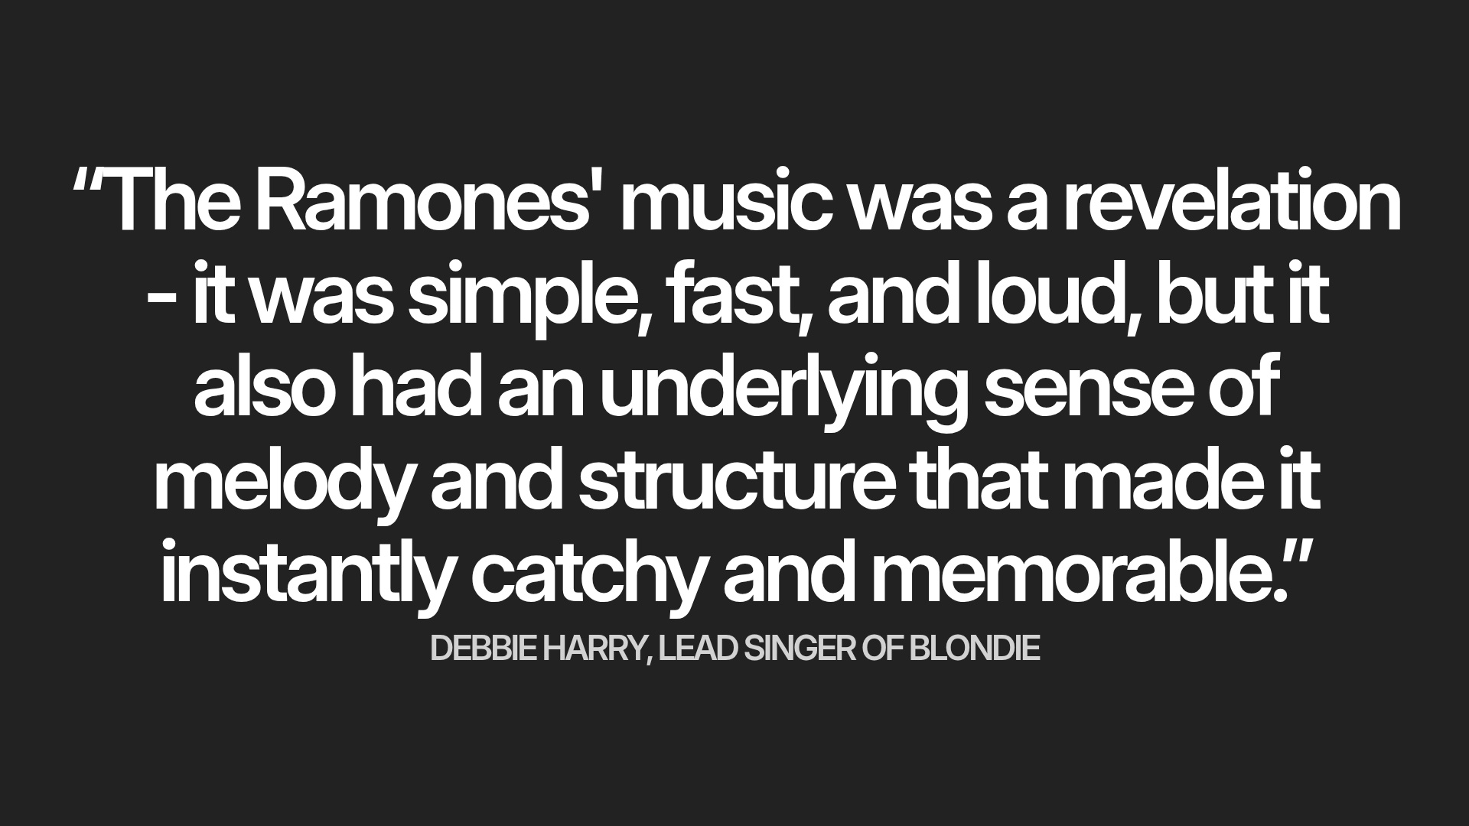

Slide 24
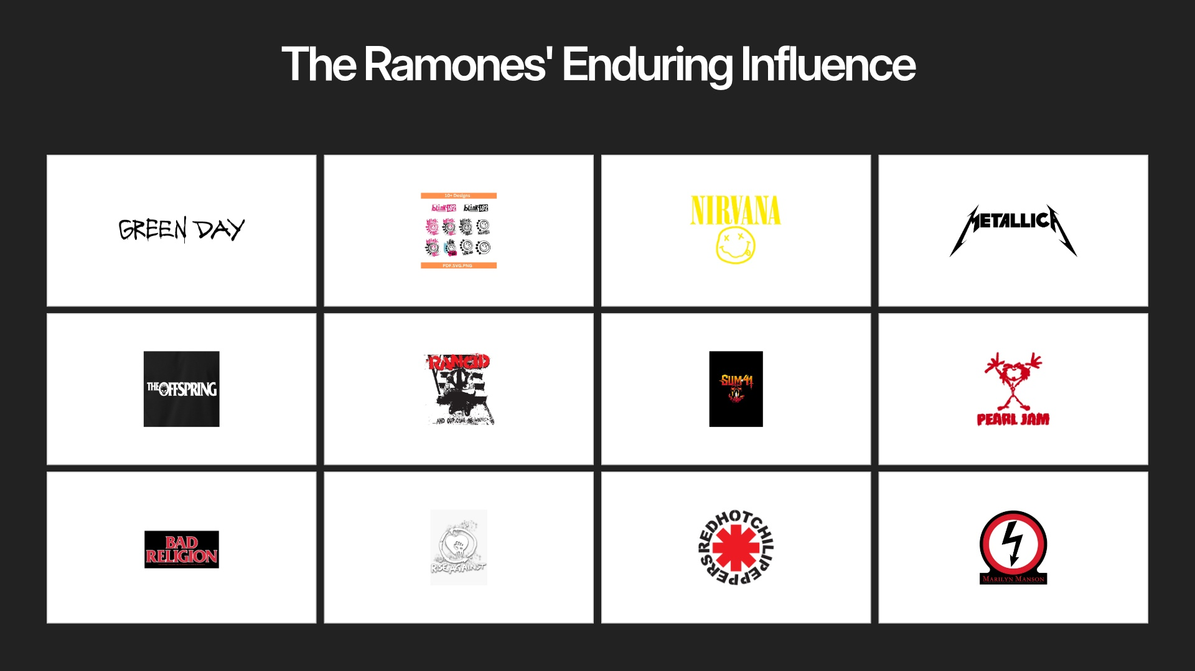

Slide 25
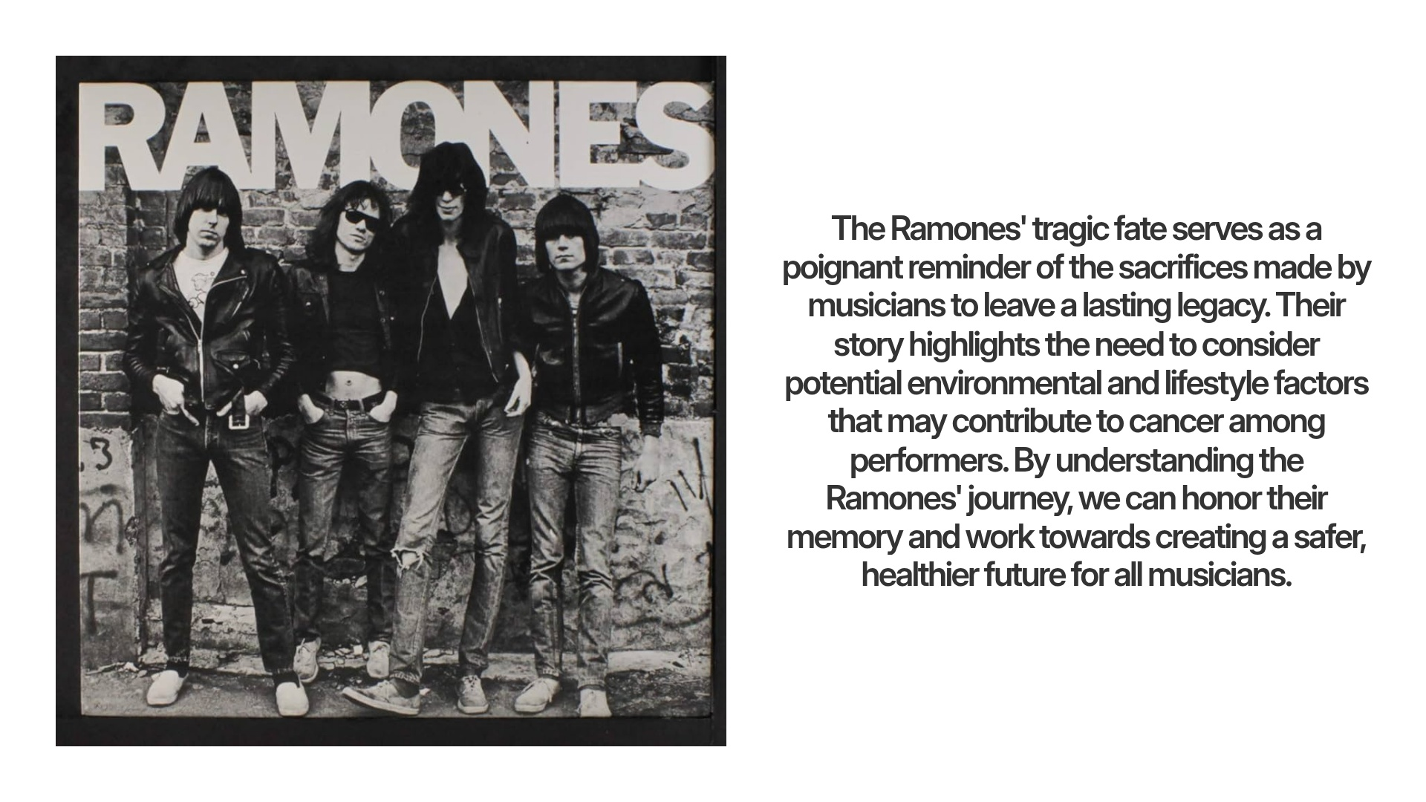

Slide 26

HEADLINER
The Temper Trap - Conditions
Release Date: June 19, 2009
Record Label: Liberation (AUS), Infectious (UK), Glassnote/Columbia (US)
Producer: Jim Abbiss
Legacy
Conditions established The Temper Trap as a significant act in the late-2000s indie rock scene. Its blend of soaring hooks and atmospheric production helped the band transition from the Melbourne indie circuit to international stages, with “Sweet Disposition” becoming one of the era’s defining indie anthems.

Slide 27
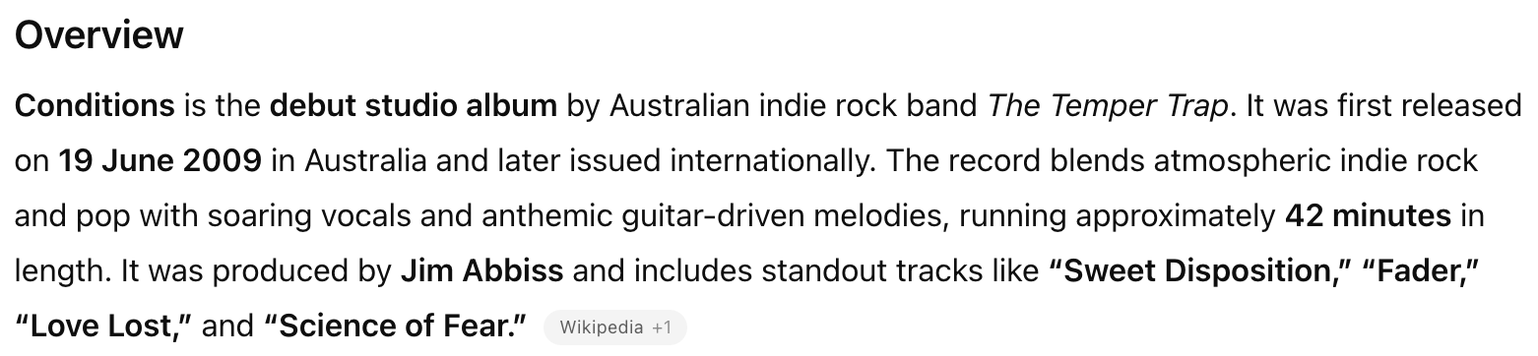
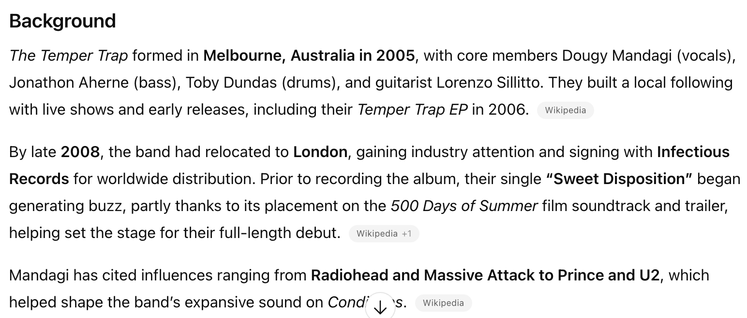
HEADLINER

Slide 28
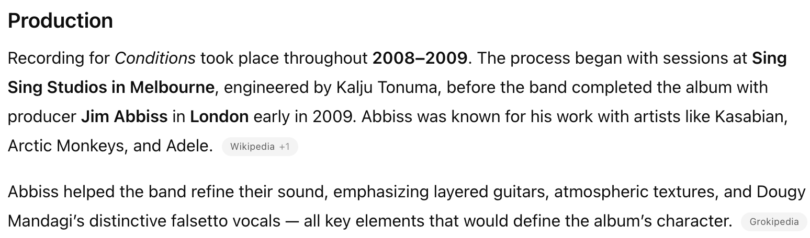
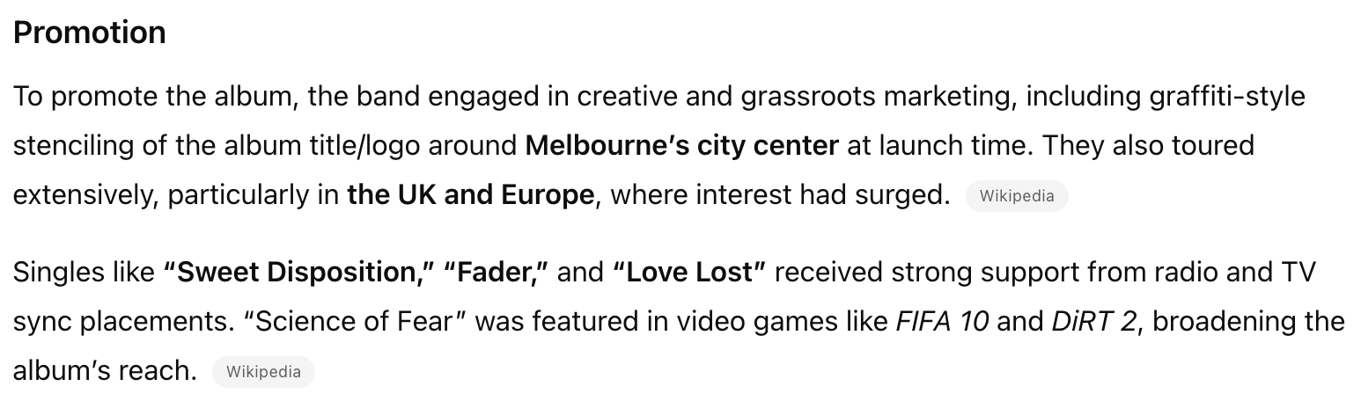
ALBUM TWO

Slide 29
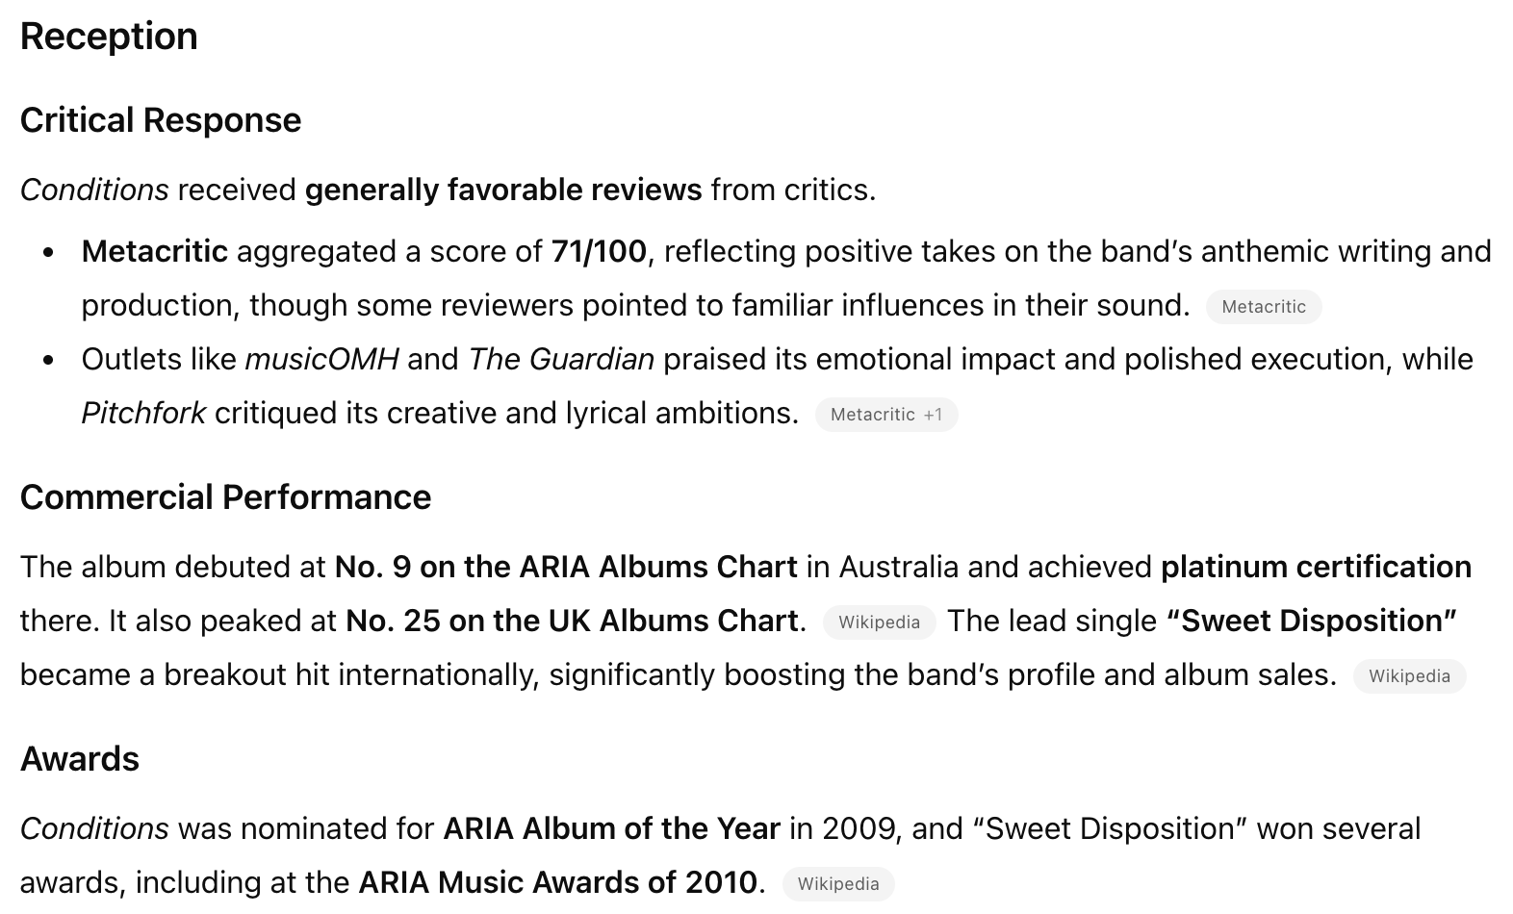
HEADLINER

Slide 30
ROTATION
Chris
Joe
John
Adam
Lucas
Whoever is MC, they have music and booze, whoever is on deck, they have notes and food. Notes taken by Adam unless not present.

Slide 31
WRAP UP
Next Meeting
Date: February 12,2026
Host: Music & Cocktails: Lucas
Food: Chris
Notes: Adam (if not present, revert to person with food)
Final Thoughts

Slide 32
APPENDICES
For reference only

Slide 33
HISTORY
# | Date | MC | Cocktail | Selections
1 | 1/22/2015 | Chris | Sazerac | King Crimson In the Court of the Crimson King
2 | 2/26/2015 | Joe | Sidecar | Mountain Nantucket Sleighride
3 | 3/27/2015 | John | Rusty Nail | Sebado, Yo La Tengo, Ben Lee
4 | 4/23/2015 | Chris | Harvey Wallbanger | The Knife Silent Shout
5 | 7/29/2015 | Joe | Rum Ball | Jefferson Airplane Surrealistic Pillow, Talking Heads Talking Heads:77
6 | 11/5/2015 | John | Old Fashion | The Afghan Whigs Black Love
7 | 12/17/2015 | Chris | Between the Sheets | The Stooges Raw Power
8 | 1/26/2016 | Joe | Whiskey Sour | James Brown Say it Loud, David Bowie tribute
9 | 3/25/2016 | Lucas | Negroni | Paul Simon Graceland, Arcade Fire Funeral, Vampire Weekend Vampire Weekend
10 | 5/26/2016 | John | Bloody Mary | The Replacements Pleased to Meet You, The Jam Setting Sons, Big Star #1 Record

Slide 34
HISTORY
# | Date | MC | Cocktail | Selections
11 | 8/10/2016 | Chris | Stinger | Joy Division Unknown Pleasures, Genesis Selling England by the Pound, Radiohead A Moon Shaped Pool
12 | 9/29/2016 | Joe | Soft Wink | Adrian Belew Young Lions, Robin Trower Bridge of Sighs, Santana Moonflower
13 | 12/8/2016 | Lucas | The Magnificent Bastard | Frightened Rabbits Midnight Organ Fight, Leonard Cohen Personal Problems, Bob Dylan Blood on the Tracks
14 | 1/26/2017 | John | Manhattan | Galaxie 500 On Fire, Morphine Cure for Pain, Built to Spill Perfect from Now On
15 | 3/9/2017 | Chris | Vieux Carre | MC5 Kick Out the Jams, Mastodon Crack the Skye, Black Sabbath Black Sabbath Vol 4
16 | 5/4/2017 | Joe | Vodka Martini (Kangaroo) | Live Mental Jewelry, Kansas Leftoverture, Allman Brothers At Fillmore East
17 | 8/10/2017 | Lucas | The Sun Also Sets | Interpol Turn On The Bright Lights, Serge Gainsbourg & Jane Burkin Jane Burkin/Serge Gainsbourg, Modest Mouse The Moon & Antarctica
18 | 9/14/2017 | John | Moscow Mule | David Bowie Pinups, Steve Earle Townes: The Basics, Kurt Vile Believe I’m Going Down, (also played*John Mayer – Where the Light Is, Steely Dan – Aja)
19 | 10/26/2017 | Chris | The Aviation | Spoon Ga Ga Ga Ga Ga, Fleetwood Mac Rumours, R.E.M. Murmur
20 | 1/25/2018 | Joe | Black Russian | Widespread Panic - VCL Mix Edition, J. Geils - The Morning After, Jethro Tull - Thick As A Brick

Slide 35
HISTORY
# | Date | MC | Cocktail | Selections
21 | 3/8/2018 | Eric | Black Ginger | Stone Roses The Stone Roses, Grouplove Never Trust a Happy Song, The Wombats Beautiful People Will Ruin Your Life
22 | 5/10/2018 | John | Old Pal | Wilco Yankee Hotel Foxtrot, Pavement Slanted and Enchanted, Sonic Youth Daydream Nation
23 | 8/9/2018 | Adam | Hemingway Daiquiri | The Orwells Discgraceland, Sleater Kinney Dig Me Out, Pixies Doolittle
24 | 11/1/2018 | Lucas | The Packie | Los Campesinos No Blues, John Prine Bruised Orange
25 | 1/24/2019 | Chris | The Scofflaw | Led Zeppelin Led Zeppelin I, Led Zeppelin Led Zeppelin II
26 | 3/7/2019 | Joe | Hurricane | Mott The Hoople All The Young Dudes, Roy Buchanan That’s What I Am Here For
27 | 5/2/2019 | Eric | Dark & Stormy | Tears for Fears Elemental, Beck Guero
28 | 9/5/2019 | John | The Kentucky Buck | Dinosaur Jr You’re Living All Over Me, J. Mascis Elastic Days
29 | 10/7/2019 | Adam | Harvest Moon Old-Fashioned | Japandroids Celebration Rock, Arcade Fire Funeral
30 | 1/23/2020 | Lucas | French 75 | Father John Misty Fear Fun, Van Morrison Astral Weeks

Slide 36
HISTORY
# | Date | MC | Cocktail | Selections
31 | 6/11/2020 | Chris | Ward 8 | Band of Horses – Everything All the Time; Brand New – The Devil and God Are Raging Inside Me; TV on the Radio – Return to Cookie Mountain
32 | 8/6/2020 | Joe | Bourbon Tasting – Beam’s Choice Collector's Edition 50+; Carleton Tower 50+; Woodford Reserve Double Oaked | Arc Angels – Arc Angels; Yes – Close to the Edge; Good Night Lights – Biggest Fears
33 | 9/24/2020 | John | Vieux Carre | The Church – Starfish; Treepeople – Something Vicious for Tomorrow / Time Whore; Joe Strummer + The Mescaleros - Streetcore
34 | 11/19/2020 | Eric | Balvenie 14 Year Old Caribbean Cask Single Malt Scotch | Van Halen – 1984; Haim – Days Are Gone; The Smiths – Louder Than Bombs
35 | 3/11/2021 | Adam | Martinez | Nehiyawak – nipiy, Miles Cane – Coup de Grace, Afghan Whigs – Up In It
 | 0 | Lucas | 0 | 0
36 | 5/13/2021 | Chris | El Presidente | Television – Marquee Moon, Devo – Q: Are We Not Men? A: We Are Devo; The Clash – London Calling
37 | 6/10/2021 | Joe | The Penicillin | Leon Bridges – Coming Home; Billie Eilish – When We all Fall Asleep, Where Do We Go; Harry Styles – Fine Line
38 | 9/7/2021 | Eric | Blood + Sand | William Orbit – My Oracle Lives Uptown; The Connells – Steadman’s Wake; The Stranglers – Dark Matters
39 | 11/23/2021 | John | 81 Old Fashion | Dry Cleaning – New Long Leg; The War on Drugs – I Don’t Live Here Anymore; My Morning Jacket – My Morning Jacket

Slide 37
HISTORY
# | Date | MC | Cocktail | Selections
40 | 04/14/2022 | Adam | Toronto | The Charlatans UK – Between 10th + 11th, Gomez – Bring It On, IDLES - CRAWLER
 | 0 | Lucas | 0 | 0
41 | 6/9/2022 | Chris | Tuxedo No. 2 | Depeche Mode – Speak & Spell; Kraftwerk – Computer World; The Police – Ghost in the Machine
42 | 7/14/2022 | Joe | Brown Derby | Beautiful Bob Seger – Live Bullet; Gil Scott-Heron – Pieces of a Man; Tears for Fears – Tipping Point
43 | 8/11/2022 | Eric | Painkiller | Echo & the bunnymen - Evergreen; Twenty One Pilots - Vessel; Metric - The Art of Doubt
44 | 9/15/2022 | John | Stone Fence | The Doors – The Doors; The Strokes – This is It
45 | 11/17/2022 | Adam | Cynar Flip | Ron Gallo - HEAVY META; The Foo Fighters – The Colour and the Shape
46 | 1/12/2023 | Lucas | Paloma | Sky Perriera – Night Time, My Time; Bloc Party – Silent Alarm
47 | 3/9/2023 | Chris | The Clover Club | Cut/Copy – In Ghost Colours; The Cure – Kiss Me, Kiss Me, Kiss Me
48 | 4/20/2023 | Joe | The New Fashioned | Supertramp – Crime of the Century; St. Paul & The Broken Bones – The Alien Coast; Sharon Jones & The Dap Kings – 100 Days 100 Nights

Slide 38
HISTORY
# | Date | MC | Cocktail | Selections
49 | 6/8/2023 | Eric | Eric’s Fancy | The Police - Zenyatta Mondatta; INXS – The Swing; Jackson Browne – Late For The Sky
50 | 7/13/2023 | John | El Diablo | Todd Rundgren - A Wizard / A True Star; Pink Floyd - Animals; Yo La Tengo - This Stupid World
51 | 9/21/2023 | Adam | Ginger Pear Bourbon | Nilüfer Yanya - PAINLESS, PJ Harvey - Stories from the City, Stories from the Sea; Yeah Yeah Yeahs - Fever to Tell
52 | 10/19/2023 | Lucas | Late Night Flight | Fall Out Boy – From Under the Cork Tree, Blink-182 – Blink-182, Taking Back Sunday – Tell All Your Friends
53 | 11/9/2023 | Chris | Turf Club | Killing Joke – Killing Joke; Tubeway Army – Tubeway Army; Nine Inch Nails – The Fragile
54 | 1/10/2024 | Joe | The Cape Codder | Neil Young & Crazy Horse at The Fillmore 1970; First Ever Film Presentation: The Last Waltz
55 | 3/14/2024 | Eric | Gold Rush | Johnny Marr + the Healers – Boomslang; Morrissey – Viva Hate; The Smiths – Hatful of Hollow
56 | 4/11/2024 | John | Godfather | Woods - Perennial; King Gizzard & the Lizard Wizard - Ice, Death, Planets, Lungs, Mushrooms and Lava; Neil Young - Chrome Dreams
57 | 5/9/2024 | Adam | Oaxaca Old Fashioned | Pet Fox - A Face in Your Life; Momma - Household Name; Shame - Songs of Praise
58 | 9/12/2024 | Lucas | Remember the Maine | Bloc Party – A Weekend in the City, Maximo Park – A Certain Trigger, Futureheads – Futureheads (Self Titled)

Slide 39
HISTORY
# | Date | MC | Cocktail | Selections
60 | 10/10/2024 | Chris | Toronto Sour | Fleet Foxes – Fleet Foxes, The National – Boxer, The Smile – Wall of Eyes
61 | 11/21/2024 | Joe | Blackberry Smash | The Beatles – Abbey Road, Tears for Fears – Songs for a Nervous Planet, Cubeart – Mobbed
62 | 1/9/2025 | John | Pendergast | A Country Western – Life on the Lawn, Young Jesus – The Fool, Kim Deal – Nobody Loves You More
63 | 3/13/2025 | Adam | Bubby’s Barrel-Aged Manhattan - Elijah Craig Small Batch Edition | Phantom Planet – Phantom Planet, MGMT – Loss of Life, The Beatles – Magical Mystery Tour
64 | 5/22/2025 | Lucas | Division Bell | Nirvana – Incesticide, Manchester Orchestra – A Black Mile to the Surface, Radiohead – In Rainbows
65 | 6/12/2025 | Chris | Paper Plane | A Certain Ratio – To Each…, Joy Division – Closer, Beach Boys – Pet Sounds
66 | 9/11/2025 | Joe | Maple Old Fashioned | Tyler Childers - Live on Red Barn Radio I and II, Imelda May - Love Tattoo, Stone Temple Pilots - Purple
67 | 11/13/2025 | John | Mexican Firing Squad | Patti Smith - Wild Horses, Sinead O’Connor - The Lion and the Cobra, Liz Phair - Exile to Guyville
68 | 1/8/2026 | Adam | C&B Old Fashioned | Boots - AQUΛRIA, Balthazar - Rats, The Temper Trap - Conditions

Slide 40
MUSICOLOGY HISTORY
Date | Host | Musicologist | Topic | Notes
1/22/15 | Chris
2/26/15 | Joe
3/27/15 | John
4/23/15 | Chris
7/29/15 | Joe
11/5/15 | John
12/17/15 | Chris |  |  | 1st Presentation deck
1/26/16 | Joe
3/25/16 | Lucas | Joe |  | 1st Reference to "Resident Musicologist, Joseph Ziegler report"
5/25/16 | John | Joe |  | 2nd Reference to "Resident Musicologist…"

Slide 41
MUSICOLOGY HISTORY
Date | Host | Musicologist | Topic | Notes
8/10/16 | Chris | Joe |  | Resident Musicologist Report reference
9/29/16 | John | Joe | Musicians Moving On
12/8/16 | Lucas | Joe | JZ Has the Floor
1/26/17 | John | Joe | The Philadelphia Sound
3/9/17 | Chris | Joe | Black Sabbath
5/4/17 | Joe | Joe | Beatles or Stones?
8/10/17 | Lucas | Joe | Bill Graham
9/14/17 | John | Joe | Glyn Johns Engineer, Producer, Mixer
10/26/17 | Chris | Joe | Behind the kit - 1971
1/25/18 | Joe | Joe | Emotional Response to Music

Slide 42
MUSICOLOGY HISTORY
Date | Host | Musicologist | Topic | Notes
3/8/18 | Eric | Joe | Disco deserves 10 minutes of our time
5/10/18 | John | Joe | The shame of the rock & roll hall of fame
8/8/18 | Adam | Joe | Pick one timeless song
11/1/18 | Lucas | Joe | AC/DC How fucked up IS this band?
1/24/19 | Chris | Joe | Number 1 song the day you were born
3/7/19 | Joe | Joe | How music affects the brain
5/2/19 | Eric | Joe | Sex, drugs, and Rock & Roll - Where did the phrase come from … beyond the obvious?
9/5/19 | John | Joe | Someone stole my song! Plagerism in Rock & Roll
10/17/19 | Adam | Joe | Contract riders - Excess and entitlement in Rock & Roll
1/23/20 | Lucas | Joe | Groupies! Ah… the ladies

Slide 43
MUSICOLOGY HISTORY
Date | Host | Musicologist | Topic | Notes
6/11/20 | Chris | Joe |  | ***Musicology was tabled until the next meeting
9/24/20 | John | Joe | Ployrythms and Polymeters - At the risk of being fired as a Musicologist…
11/19/20 | Eric | Joe |  | ***unclear what topic was covered
3/11/21 | Adam | Joe | Hilarious Band Names - Weevie Stonder
5/13/21 | Chris | Joe | Who Would You Pick? If you could see one show/performance of a person or band that is dead or broken up, who and why?
6/10/21 | Joe | Joe | Time Signature - it's fucking hard
9/7/21 | Eric | Joe | Breaking Music in television
11/23/21 | John | Joe | Famous musicians from Toledo OH
4/14/22 | Adam | Joe | RIP Michael Lang - Woodstock 1969
6/9/22 | Chris | Joe | Glen Campbell

Slide 44
MUSICOLOGY HISTORY
Date | Host | Musicologist | Topic | Notes
11/17/22 | Adam | Joe | Akron Porch Rocker!
1/12/23 | Lucas | Joe | Albums of the year
3/9/23 | Chris | Joe | Top Selling albums all time!
4/20/23 | Joe | Joe | Who got paid WHAT? At Woodstock 1969
6/8/23 | Eric | Joe | Stevie Moore - The Godfather of home recording
7/13/23 | John | Joe | Now famous backup singers
9/21/23 | Adam | Joe | Repeated lines in songs
10/19/23 | Lucas | Joe | Musical heroes
11/9/23 | Chris | Joe | The Band
1/10/24 | Joe | Joe | Movie Night! - The Last Waltz

Slide 45
MUSICOLOGY HISTORY
Date | Host | Musicologist | Topic | Notes
3/14/24 | Eric | Joe | Where did Rock come from?
4/11/24 | John |  |  | ***No musicology conducted - Changing of the arms
5/9/24 | Adam | Chris | 1994 – The Pinnacle of Alternative Rock?
9/12/24 | Lucas | Chris | The Krautrock Influence on music in the 1970s and beyond
10/10/24 | Chris | Joe | Frontman
11/21/24 | Joe | Chris | Quincy Jones
1/9/25 | John | Chris | Top 5 analysis
3/13/25 | Adam | Chris | David Bowie’s Berlin Trilogy
5/22/25 | Lucas | Chris | The Significance of CBGB’s to Punk, Alt, etc.
6/12/25 | Chris | Chris | The Legendary Brian Wilson & the Pioneering sounds of the Beach Boys

Slide 46
MUSICOLOGY HISTORY
Date | Host | Musicologist | Topic | Notes
9/11/24 | Joe | Joe | Working for the Mob
11/13/24 | John | Joe | Paul McCartney
1/8/26 | Adam | Chris | The Tragic Fate of The Ramones

